Slide 1
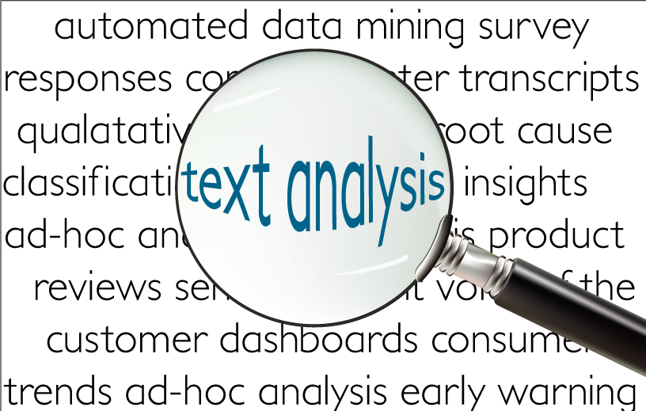
Text Analytics

Slide 2
MKT 591: Course Roadmap
Review of Quant Market Research
Prediction / Regression
Forecasting
Features & Dimensions
Market Segmentation
Simple Linear Regression
Demand Forecasting
Customer Classification
Factor Analysis
Segmentation Basic
Measurement Scales
Categorical Variables
BASS Diffusion Model
Discriminant Analysis
MDS
Advanced Model-based Segmentation
Discrete Analysis (CrossTab)
Extracting Features by Text Analytics
Multiple Regression
Bayesian Classifier
Spatial Segmentation
Continuous Analysis (Correlation)
Issues in Regression
Tree Models
Deep Learning
Logistic Regression (Consumer Choice)

Slide 3
Text Analytics Topics
Conceptual background
Application Examples
Collecting Online Text data
Text Mining Implications
Preprocessing (Cleaning data)
Word matrix
Searching frequent words
Word Associations
Sentiment Analysis
Machine Learning Approach
Dictionary Based Approach
Notes:
LIWC

Slide 4
Unstructured Data
Unstructured data refers to information that either does not have a pre-defined data model or is not organized in a pre-defined manner.
Unstructured information is typically text-heavy, but may contain data such as dates, numbers, and facts as well (wiki 2016).
This results in irregularities and ambiguities that make it more challenge to analyze its pattern.
In 1998, Merrill Lynch cited a rule of thumb that somewhere around 80-90% of all potentially usable business information may originate in unstructured form (Intelligent Enterprise, 2005)

Slide 5
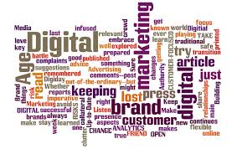
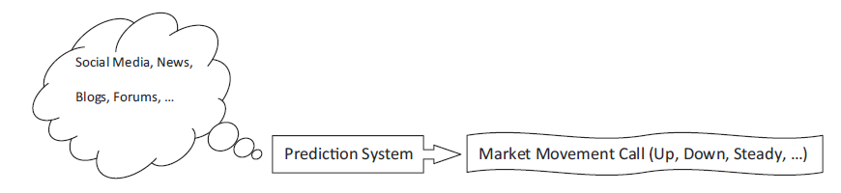
Why text analytics?
Historically, quantitative, structured data has been used but unstructured textual data is getting more attention.
Unstructured data is more challenging to analyze.

Slide 6
Text Analytics study in Marketing
Computational modeling or artificial intelligence to identify possible relationships between the textual information and the economy.
Interdisciplinary background
Understand Nature of Texts (language)
Linguistics
Computational Modeling and Pattern Recognition
Machine Learning
Marketing (Business)
Marketing Interpretation and implementation

Slide 7
Example of Unstructured Data: Online Word-of-Mouth Effects
Passing information between a non-commercial communicator (i.e., not rewarded) and a receiver.
E-WOM: It includes both structured (e.g., star ratings) and unstructured (e.g., textual writing) information.
Consumers are posting their reviews to online spaces such as product review websites, blogs, tweeters and brand communities.
Lots of evidences for significant effect of WoM on consumer behavior or Sales (Eliashberg et al. 2000, Reichheld and Teal 1996). – Managers should care!

Slide 8
Example in Marketing: Various Online Data (Voice of Consumers)
Online consumer ratings are the second most trusted source of information next to direct recommendations from family or friends (Nielsen 2012).
90% of respondents are influenced by positive online reviews on their buying decisions (Survey of Dimensional Research, 2013).
It is relatively easy to analyze quantified (star) ratings but it can be more challenging to analyze unstructured textual reviews.
Huge literature about voices of consumers in Marketing (e.g., Griffin and Hauser 1993)

Slide 9
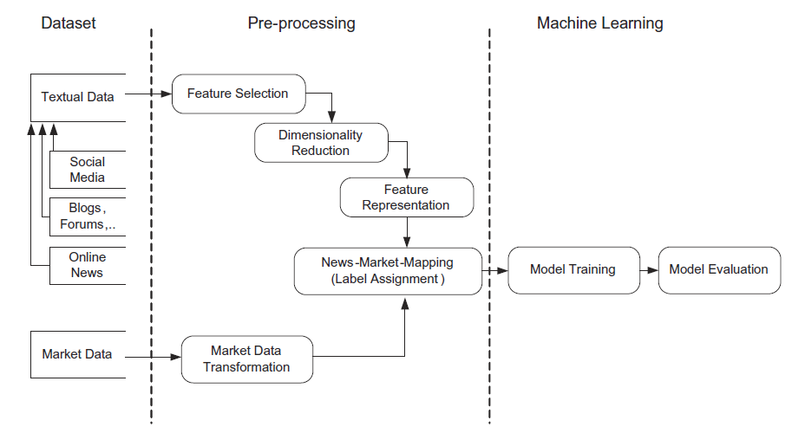
Example Procedure to apply text mining

Slide 10
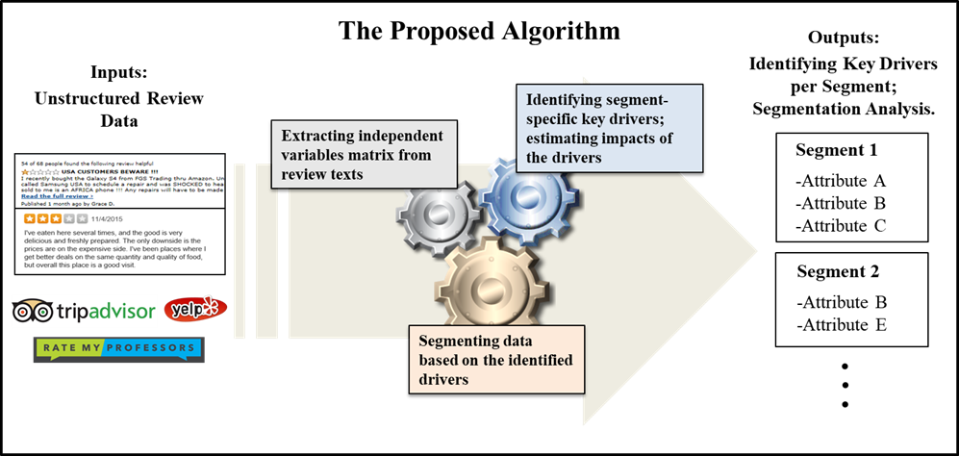
Example 1: Segmentation Algorithm with Unstructured data (Kim 2019)

Slide 11
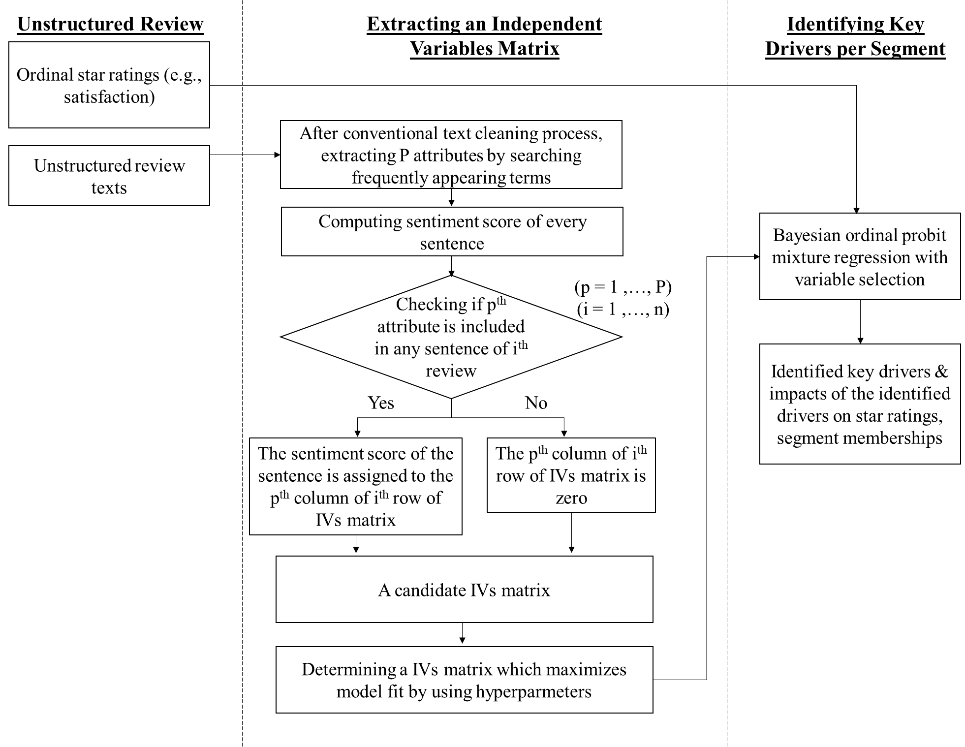
A Flow Map of The Proposed Algorithm for Unstructured Review Data

Slide 12
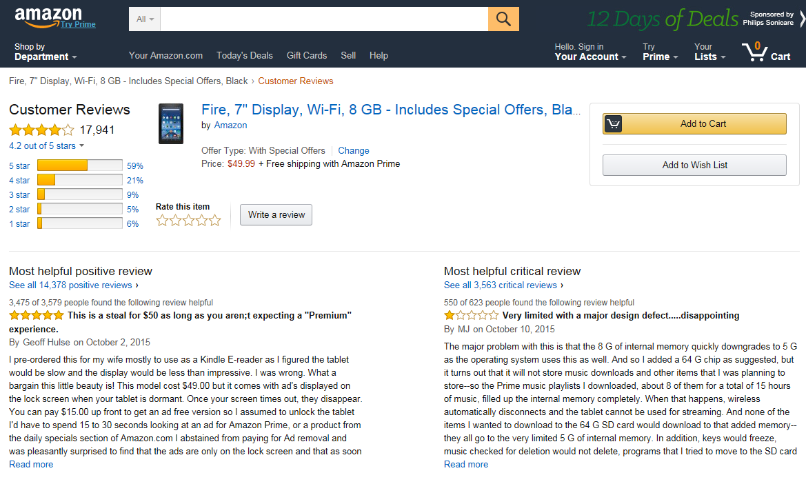
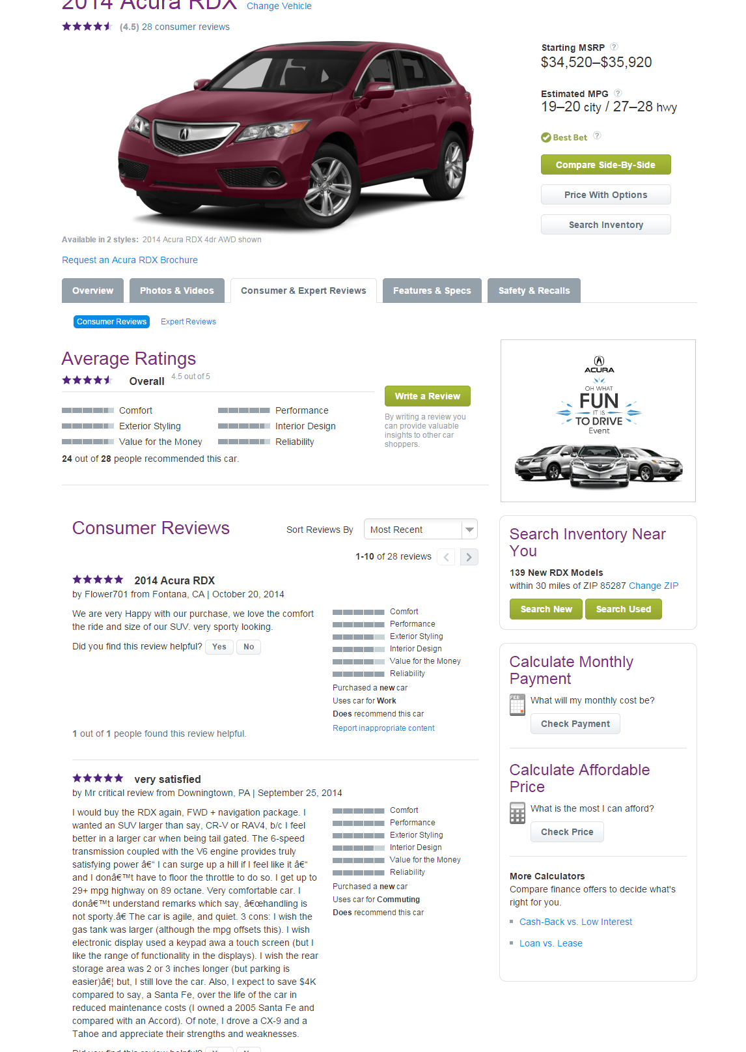
Example: Online Review Data

Slide 13
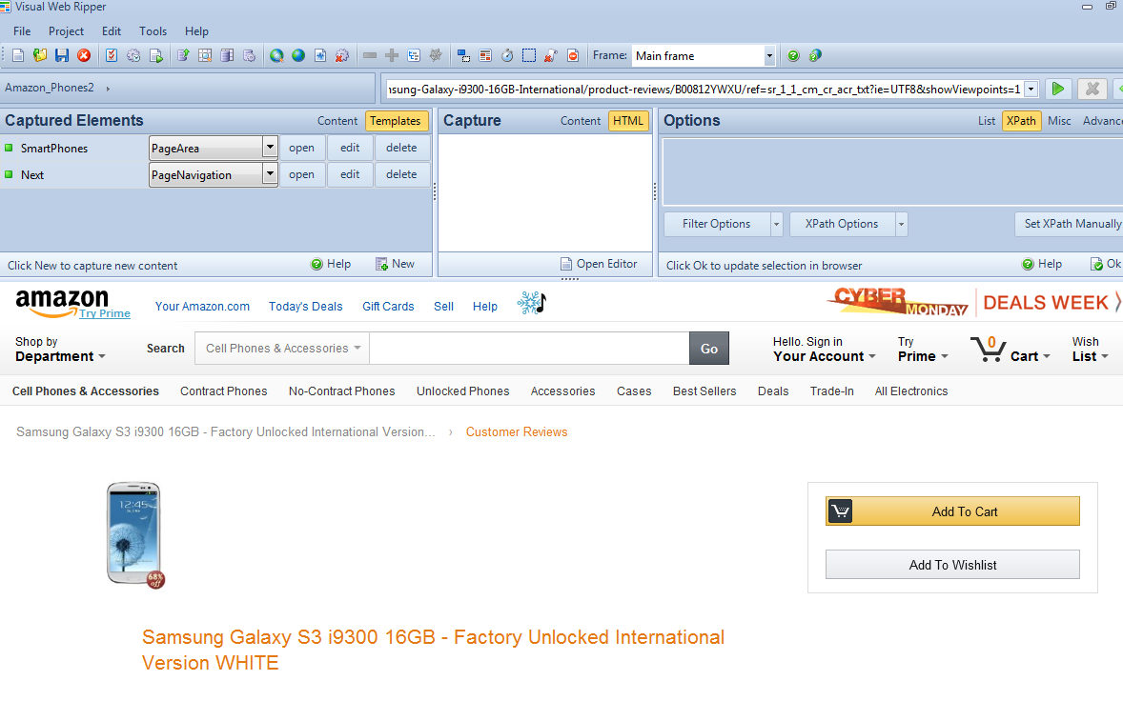
Web Data Collection
Web Scrapping (Web data extraction): a computer software technique of automatically extracting information from websites.
How: external service firms, commercial software (e.g., Visual Web Ripper, CloudScrape, etc.), programming for ourselves (with Python or R).

Slide 14

In-Class Example: Twitter Data Collection Example
Let’s try to collect Twitter Data in R.
Let’s practice keywords of “AlphaGo”
Let’s build textual data (i.e., Corpus).

Slide 15
Objectives of Text Mining
Identifying novel and meaningful information from a collection of texts for educated marketing decisions.
https://www.coursera.org/course/textanalytics
In my opinion, this area still keeps being developed with more elaborate algorithms and there are one or two established solutions yet – We should keep watching and checking any updated methods.

Slide 16

Text Mining
Text data mining, roughly equivalent to text analytics: the process of deriving high-quality information from text.
Involves the process of structuring the input text:
parsing, along with the addition of some derived linguistic features and the removal of others, and subsequent insertion into a database.
It can include: word frequency distributions, text categorization or clustering, sentiment analysis, etc.
In R, we use tm package.

Slide 17
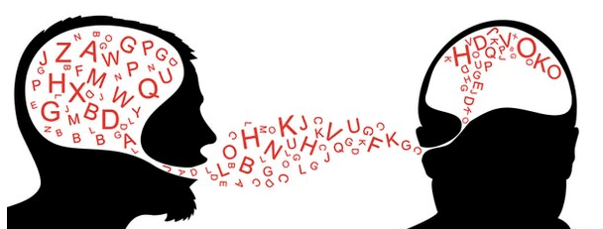
Natural Language Processing
Natural language processing (NLP) is a subfield of artificial intelligence and linguistics.
It studies the problems of automated generation and understanding of natural human languages.
Statistical natural language processing uses stochastic, probabilistic and statistical methods to resolve some of the difficulties :
e.g. text segmentation.

Slide 18
Useful example packages in R
“tm” package (Ingo Feinerer, 2018):
Can be used for various preprocessing of documents:
E.g., change all letters to lower cases; remove any stop words, any numbers or punctuations, etc.
Can build word matrix
Can search frequent terms with a certain criteria.
“openNLP” package (Kurt Hornik, 2016):
The Apache OpenNLP library is a machine learning based toolkit for the processing of natural language text.
Supports the some NLP tasks, including tokenization, sentence segmentation, part-of-speech tagging, named entity extraction or parsing.
We can search noun words using POS tagging here.
Note: You don’t have to remember those, but when you start text mining, search and save your R-codes once you successfully run it!

Slide 19
Basic Concepts and Terms
Corpus
A collection of text documents.
Representing and computing on corpora; Corpora are collections of documents containing (natural language) text.
To conduct text mining analysis (e.g., topic model), we have to prepare the corpus.
Please use Package ‘tm’

Slide 20
Preprocessing steps for text analysis
Remove stop words from context texts (e.g., i, me, which, etc.)
Remove Numbers or Punctuations
Strip extra whitespace from a text document.
Change all documents to lower cases (avoid any possible missing due to case sensitivity.
Let’s see examples in R (using Amazon smartphone reviews)

Slide 21
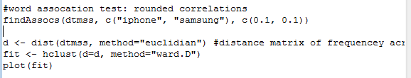
Hierarchical Clustering (let’s see how to do this in R)

Slide 22

In-Class Practice
Let’s use “Samsung_S3_S4_iPhone_4S_5.csv” file.
Online consumer review data about Samsung S3 and S4 and iPhone 4S and 5.
Import data and let’s try this

Slide 23
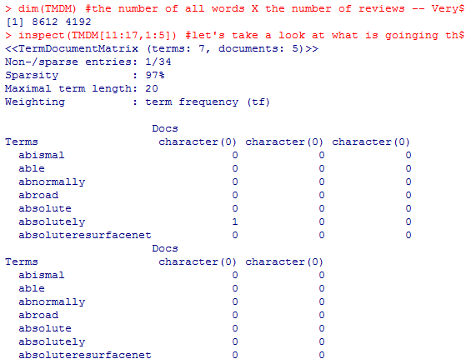
Word Matrix
TermDocumentMatrix in tm
Constructs a term-document matrix or a document-term matrix
Necessary for various quantitative analyses (e.g., word counting)

Slide 24
Search Frequent terms / Search Nouns
From the word matrix
Using a example “findFreqTerms(,)”
Check the number of frequent nouns based on the frequency criteria
Nouns can be assumed to have information of product features (Hu and Liu 2004)
Let’s use Part-Of-Speech Tagger (POS Tagger): that reads text in some language and assigns parts of speech to each word (and other token), such as noun, verb, adjective, etc.,

Slide 25
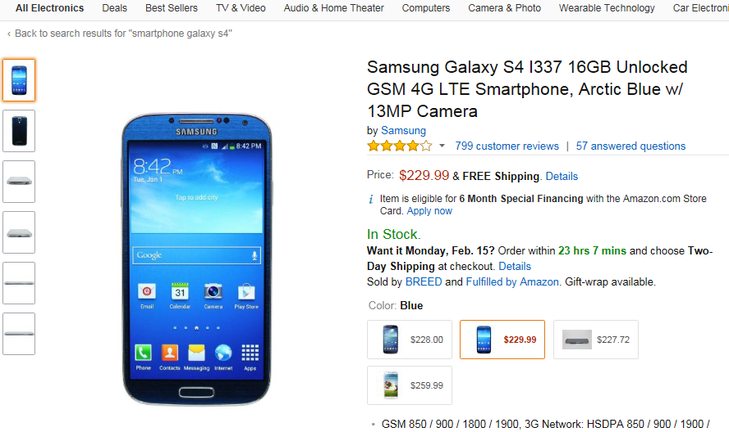
More frequency analysis in R
Frequency Table / Cross Tab Analysis
Across 12,146 online reviews for four smartphone brands (iPhone 4s, iPhone 5, Samsung S3, Samsung S4)
Let’s try the feature word “Battery” for frequency analysis

Slide 26
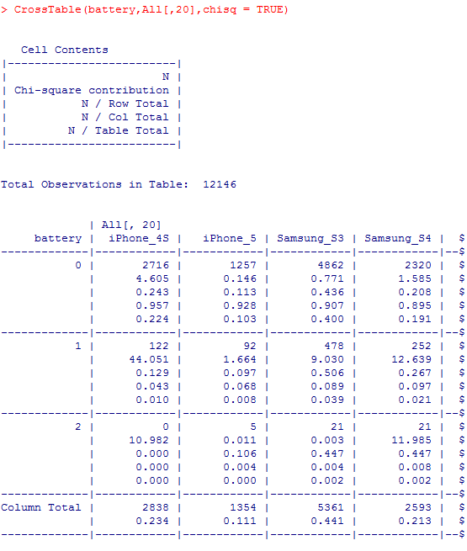

Cross Tab of Word Frequency
We found p-value for CrossTab is significant (p<0.01)
It shows that “battery” term has been appeared more in reviews of Samsung phones.
What are marketing implications?
Notes:
Coded as “1”: The word “battery” appeared 1 to 3 times

Slide 27
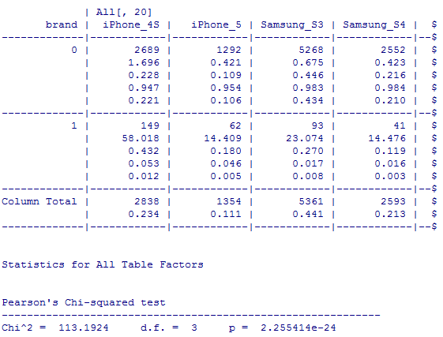
Let’s try “Brand” term. What can we find?
Notes:
Brand “1” appears more than 1

Slide 28
Topic Models (Blei, NG and Jordan 2003)
In machine learning and natural language processing, we want to understand abstract topics or underlying dimensions in large number of documents; search interesting words.
What is a topic: “a recurring pattern of co-occurring words”: A topic modeling tool look for the clusters of words and groups them together by a process of similarity.
For example, “navy, ship, captain” and “tobacco, farm, crops”.
A method for finding and tracing clusters of words (called topics in shorthand) in large bodies of texts.

Slide 29
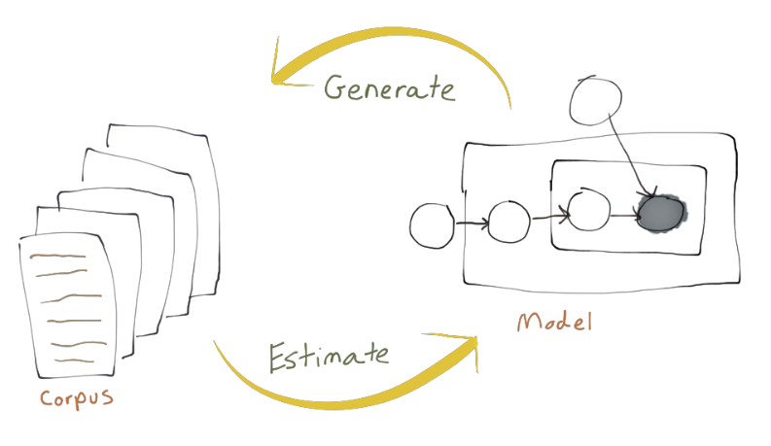
How it works?
The model assumes the existence of finite number of latent topics that appear across multiple documents (corpus).
Clustering all words into the prespecified number of discrete topics based on frequency of word appearances in each document.
E.g., "dog" and "bone" will appear more often in documents about dogs, "cat" and "meow" will appear in documents about cats.
https://vimeo.com/53080123 (If you are interested in more details)

Slide 30
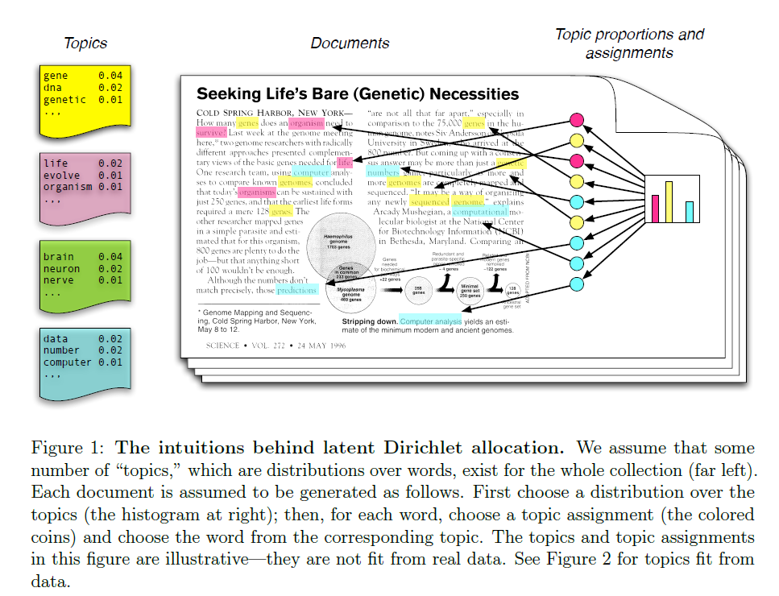
Blei, D. 2012. “Probabilistic Topic Models.” Communications of the ACM 55 (4): 77–84. doi: 10.1145/2133806.2133826

Slide 31
Simple example in R: topic models
Latent Dirichlet Allocation (LDA) – Blei, Ng and Jordan 2002.
Let’s see Topic Model Application Examples in Recent Marketing Papers
“Sentence-based Text Analysis for Customer Reviews” by Buschken and Allenby (2016)
“Mining Marketing Meaning from Online Chatter” by Tirunillai and Tellis (2014)
“topicmodels” in R Package

Slide 32
Sentiment Analysis or opinion mining
Classifying the polarity of text – whether the expressed opinion in a document, a sentence or an entity feature/aspect is positive, negative or neutral.
Advanced, “beyond simple polarity” sentiment classification looks “angry”, “sad” and “happy”.
In my opinion, artificial Intelligence capability in this sentence classification has some limitations – it means huge potential for future research!

Slide 33
Text Sentiment Analysis
Statistical (machine-learning) approach
E.g. Kim (2014) – using Convolutional NN
Limitation: we need sizable, quality training dataset.
Lexicon-based (dictionary-based) approach
Hu and Liu
LIWC (http://liwc.wpengine.com/)
‘qdap’, ‘sentiment’, etc. R package
Limitation: performance depends on quality of dictionary (we might need industry-specific dictionary).
It’s an on-going research topic. We might need one semester only for doing this… ☺

